Slide 1
STEM Camp: Bridge Design

Slide 2
Agenda
What is bridge design and why is it important?
What are important things to consider during bridge design?
Challenge!

Slide 3
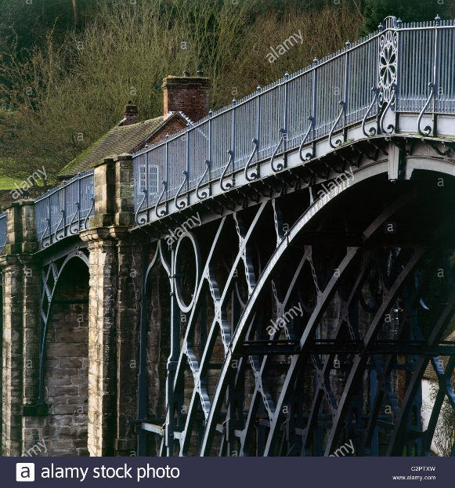
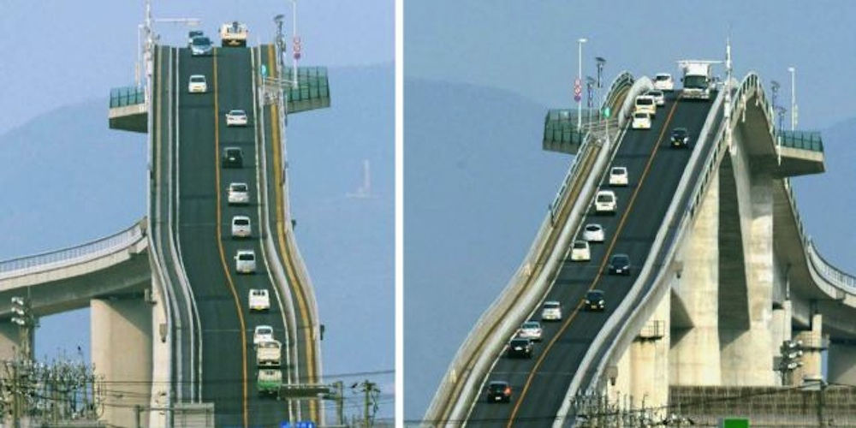
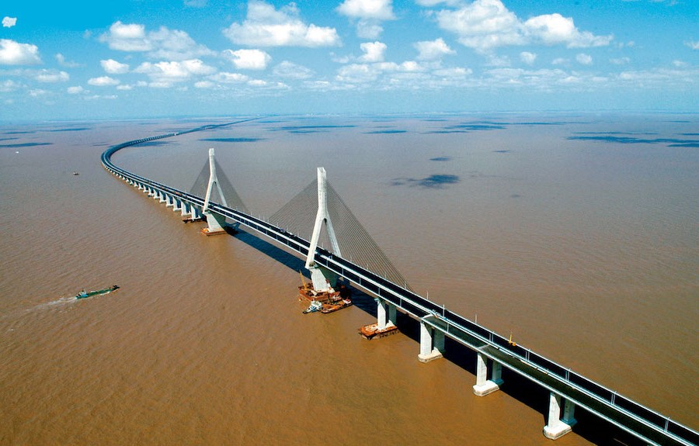
Bridge Design
If we wanted the “best” possible bridge, we would want unlimited time, unlimited materials, and no specifications. But that’s not how real life works!
Lots of time!
Few specifications
Lots of materials!
Notes:
Time: https://images.app.goo.gl/D59F43zREfhShXk67
Materials: https://img-cdn.brainberries.co/wp-content/uploads/2019/11/Donghai-Bridge.jpg
No Specifications: https://i2-prod.mirror.co.uk/incoming/article5601160.ece/ALTERNATES/s1200b/PAY-Eshima-Ohashi-Bridge.jpg

Slide 4

Bridge Design
To make the most of the time and materials, engineers make sure to plan out how their bridge will work before even picking up a hammer.
Thankfully many studies have been done to find some great designs that make the most of the time and materials engineers have.
Notes:
Image: https://s3-cf.prod.veem.com/wp-content/uploads/2020/01/31125242/time-4559218_640-640x385.jpg

Slide 5
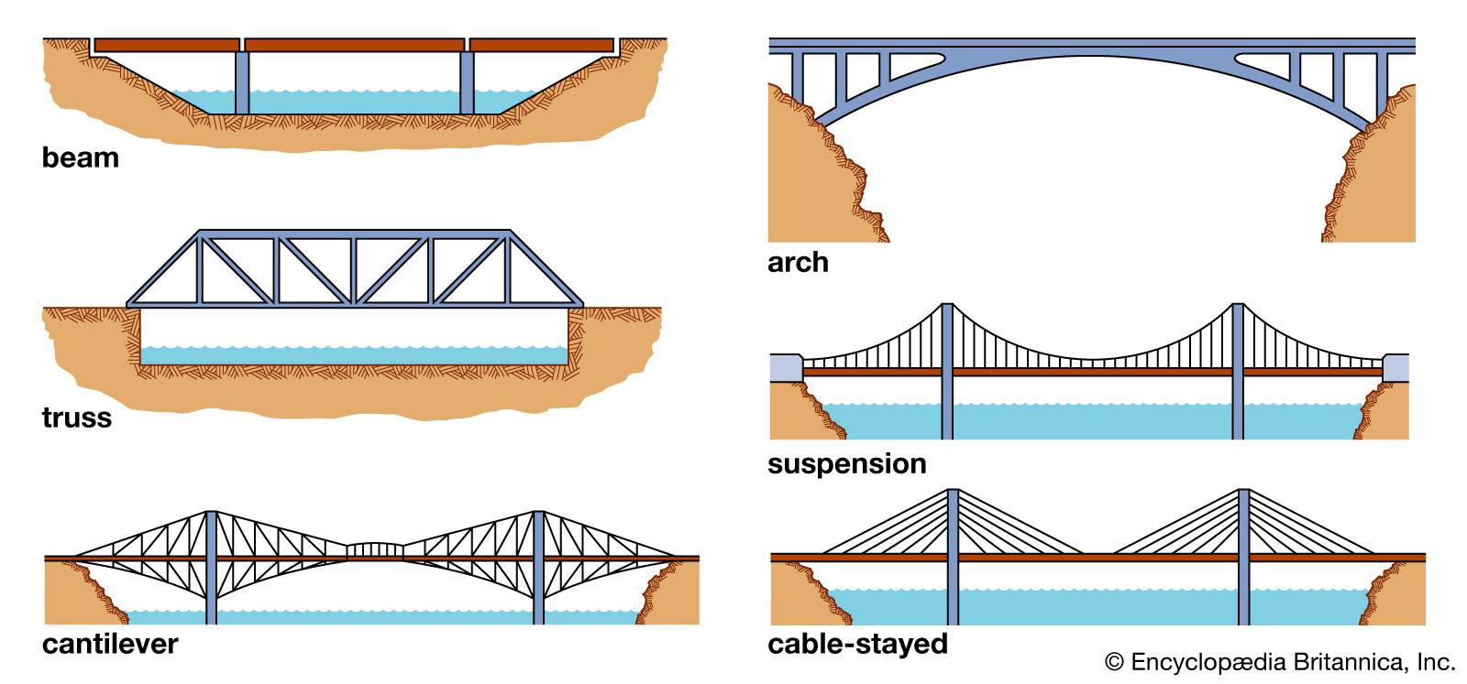


Types of Bridges
Cheap, Easy to Build
Short spans
Aesthetically pleasing, Medium Spans
Hard to build, extensive falsework
Cheap, Medium Spans
Less aesthetically pleasing
Very long spans, aesthetically pleasing
Very expensive to build
You will build a truss bridge today!
Easier to construct than suspension bridges
Less aesthetically pleasing, hard to maintain
Medium spans, aesthetically pleasing
Expensive to build
Notes:
https://www.britannica.com/technology/bridge-engineering

Slide 6
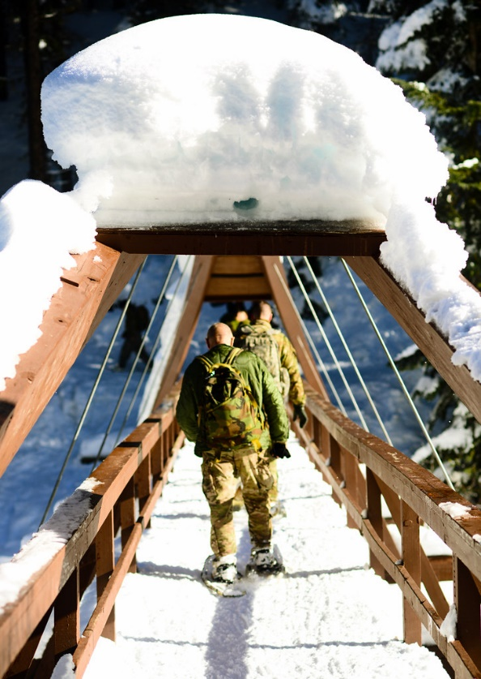
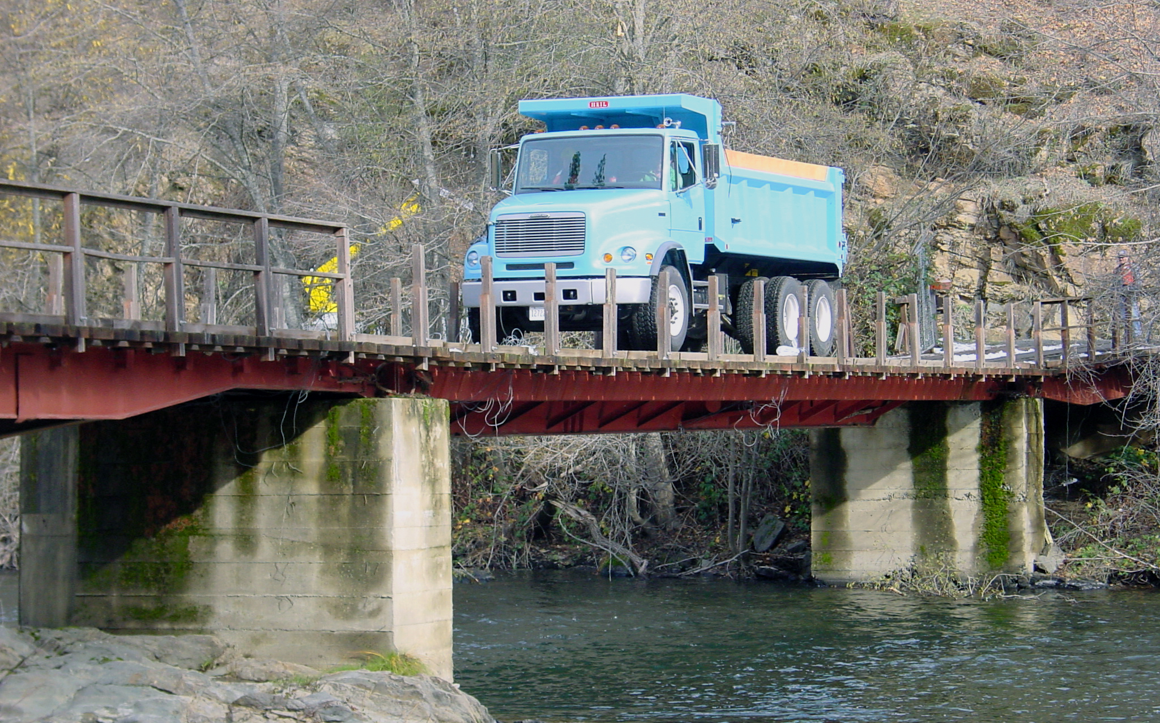
Is it really this simple?
Bridges are not always loaded the same way. Sometimes you’ll have distributed or point loads and you must design bridges to accommodate these scenarios.
Notes:
Distributed Snow Load: https://live.staticflickr.com/4815/47013911201_3a3be33b91_b.jpg
Point Load (Truck): https://bditest.com/wp-content/uploads/2013/03/bridge-load.jpg

Slide 7
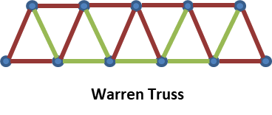
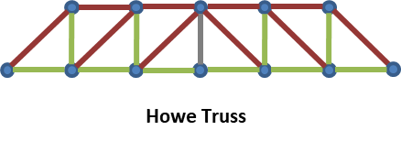
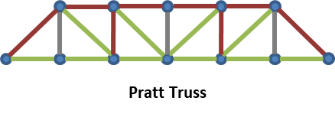
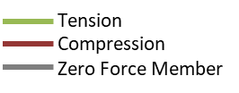
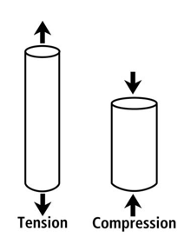
How does this apply to Truss Bridges?
Isosceles Triangles
no vertical members
No zero force members
Diagonal members are in compression
Vertical members in tension
You’ll want to think about which members of your truss are in compression and which are in tension when designing your bridge!
Most diagonal members are in tension
Vertical members in compression
Notes:
Compression members must be larger than tension members under the same magnitude of force to resist buckling. Efficient truss shapes direct compression forces through shorter members and tension forces through longer members.
Steel members perform better under tension than compression because long, slender members tend to buckle under compression. The Pratt Truss is very economical for steel because more of the long members (the diagonals) are in tension rather than compression.
https://www.britannica.com/technology/bridge-engineering

Slide 8
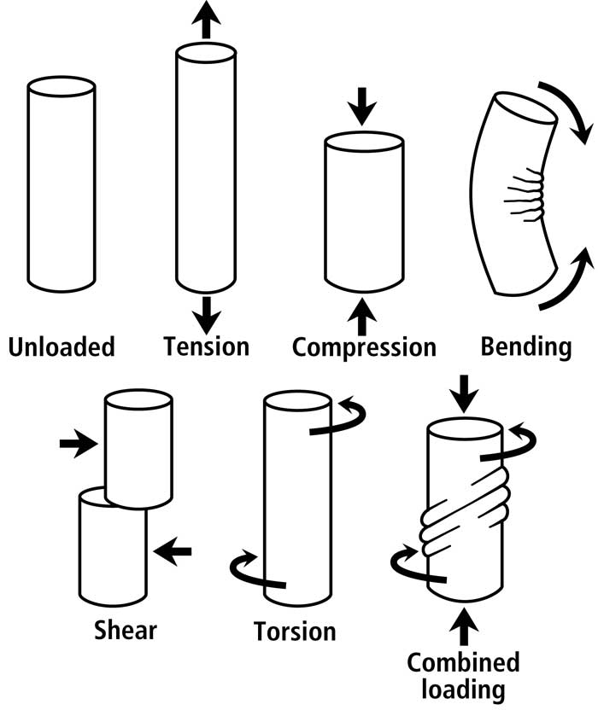
Forces/Failure Mechanisms
Engineers use a tool called a “free-body diagram” to help determine which members are in tension or compression. Understanding the kinds of loads and forces experienced by each member of a truss can determine the kind of failure a member could experience if the bridge isn’t designed properly.
Tension –
- excessive deformation
- rupture
Compression –
- Crushing (short columns)
- Buckling (long, slender columns)
Shear – caused by offset forces moving in opposite directions
Flexure – beams
Creep – prolonged loading
Fatigue – cyclic loading
Failure can occur at members or joints.
Notes:
Pool noodle or foam with horizontal black lines to show the effects of the forces above on each member.

Slide 9
Challenge Time!

Slide 10
Build your Bridges!
Time: 45-minutes for construction, 24 hours for drying
Materials: 100 popsicle sticks, 4oz bottle of wood glue, 6 binder clips
Specifications: Must span a 15-inch gap, must contain a flat portion of the bridge to hold books, must contain only wood and wood glue, must carry a minimum of 10 lbs
Tips:
Come up with a design before picking up a popsicle stick!
Consider how to transition from a popsicle oriented vertically to a horizontally oriented popsicle stick.
Use clamps to hold popsicle sticks together while drying.
Decide on have a deck on the top or bottom of the truss.

Slide 11
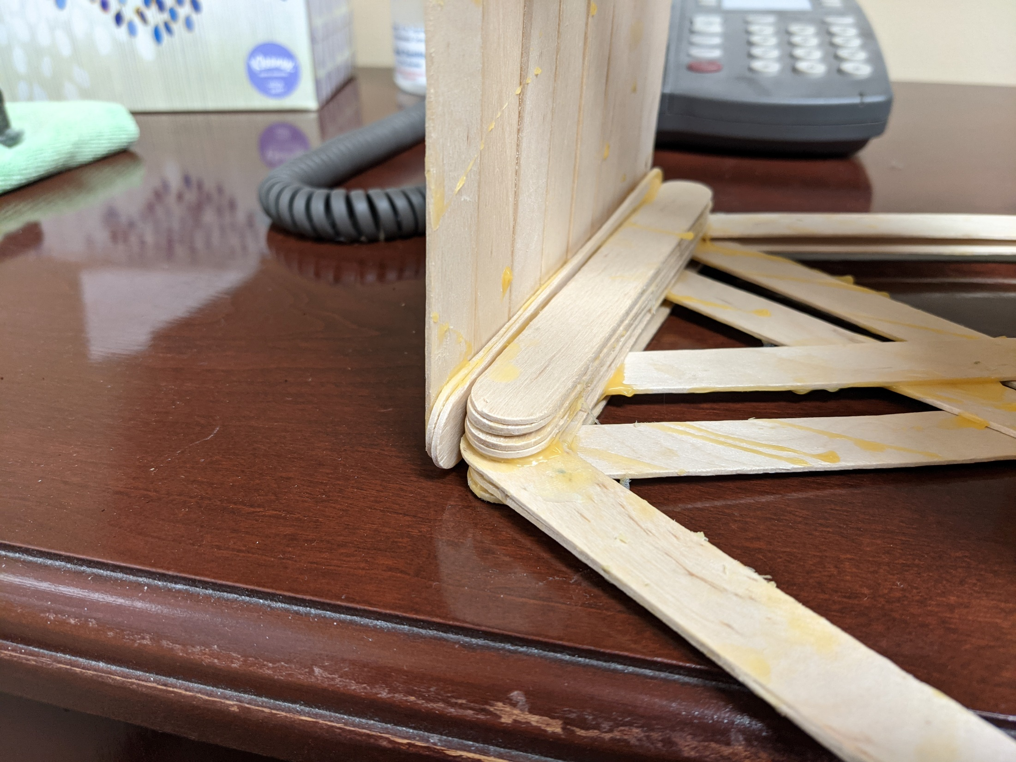
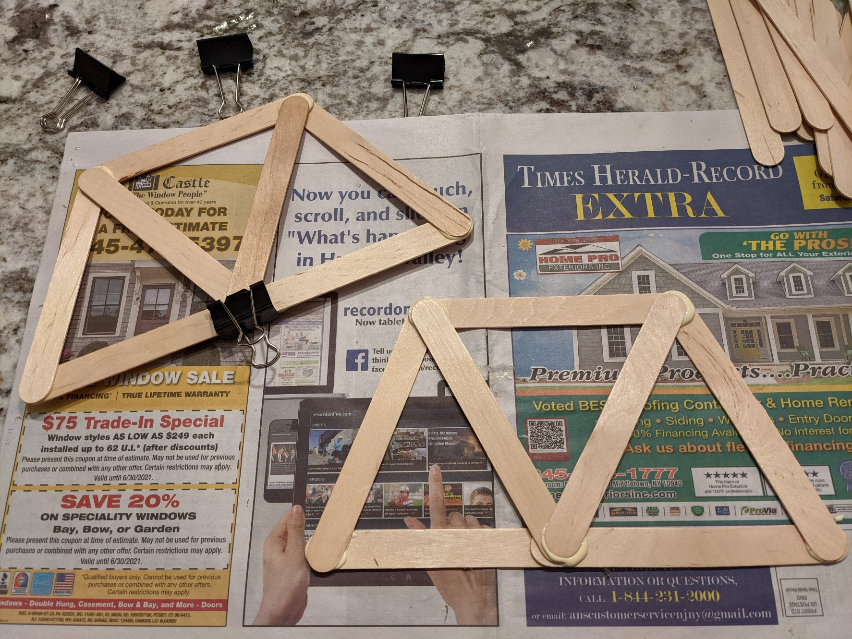
Examples
Using binder clips to hold popsicle sticks together while drying.
Transitioning from horizontal to vertical popsicle sticks.

